Slide 1
Virtualization Technology
Zhiming Shen

Slide 2
Virtualization: rejuvenation
1960’s: first track of virtualization
Time and resource sharing on expensive mainframes
IBM VM/370
Late 1970’s and early 1980’s: became unpopular
Cheap hardware and multiprocessing OS
Late 1990’s: became popular again
Wide variety of OS and hardware configurations
VMWare
Since 2000: hot and important
Cloud computing
Docker containers

Slide 3
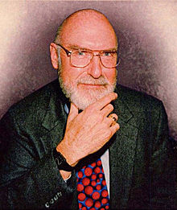
IBM VM/370
Robert Jay Creasy (1939-2005)
Project leader of the first full virtualization hypervisor: IBM CP-40, a core component in the VM system
The first VM system: VM/370

Slide 4
IBM VM/370
Conversational Monitor System (CMS)
Specialized VM subsystem (RSCS, RACF, GCS)
Mainstream OS (MVS, DOS/VSE etc.)
Another copy of VM
Virtual machines
Hypervisor
Control Program (CP)
Hardware
System/370

Slide 5
IBM VM/370
Technology: trap-and-emulate
Application
Problem
Kernel
Privileged
Trap
Emulate
CP

Slide 6
Virtualization on x86 architecture
Challenges
Correctness: not all privileged instructions produce traps!
Example: popf
Performance:
System calls: traps in both enter and exit (10X)
I/O performance: high CPU overhead
Virtual memory: no software-controlled TLB

Slide 7
Virtualization on x86 architecture
Solutions:
Dynamic binary translation & shadow page table
Hardware extension
Para-virtualization (Xen)

Slide 8
Dynamic binary translation
Idea: intercept privileged instructions by changing the binary
Cannot patch the guest kernel directly (would be visible to guests)
Solution: make a copy, change it, and execute it from there
Use a cache to improve the performance

Slide 9
Dynamic binary translation
Pros:
Make x86 virtualizable
Can reduce traps
Cons:
Overhead
Hard to improve system calls, I/O operations
Hard to handle complex code

Slide 10
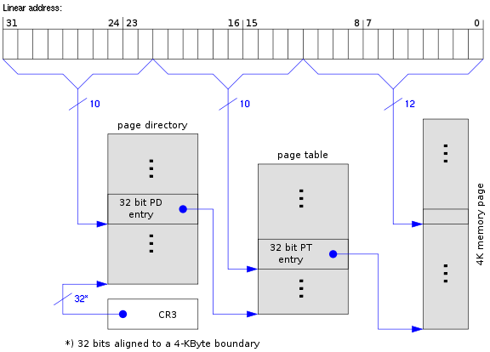
Shadow page table

Slide 11
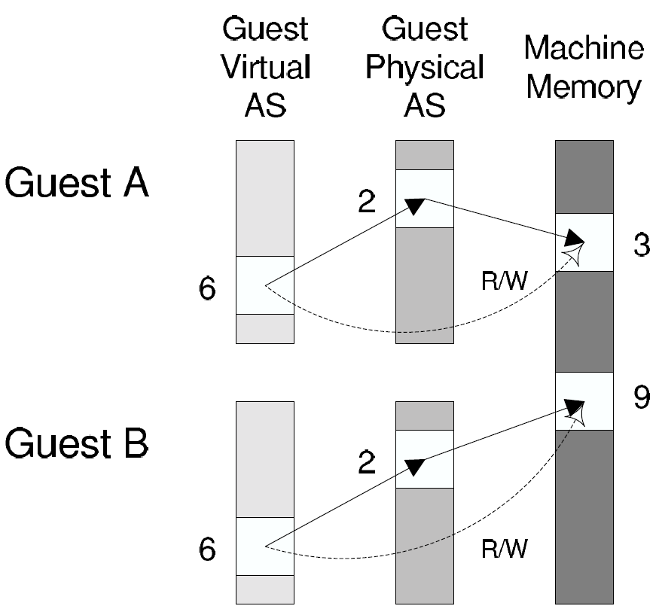
Shadow page table
Guest page table
Shadow page table

Slide 12
Shadow page table
Pros:
Transparent to guest VMs
Good performance when working set is stable
Cons:
Big overhead of keeping two page tables consistent
Introducing more issues: hidden fault, double paging …

Slide 13
Hardware support
First generation - processor
Second generation - memory
Third generation – I/O device

Slide 14
First generation: Intel VT-x & AMD SVM
Eliminating the need of binary translation
Host mode
Guest mode
Ring3
Ring3
VMRUN
Ring2
Ring2
Ring1
VMEXIT
Ring1
Ring0
Ring0

Slide 15
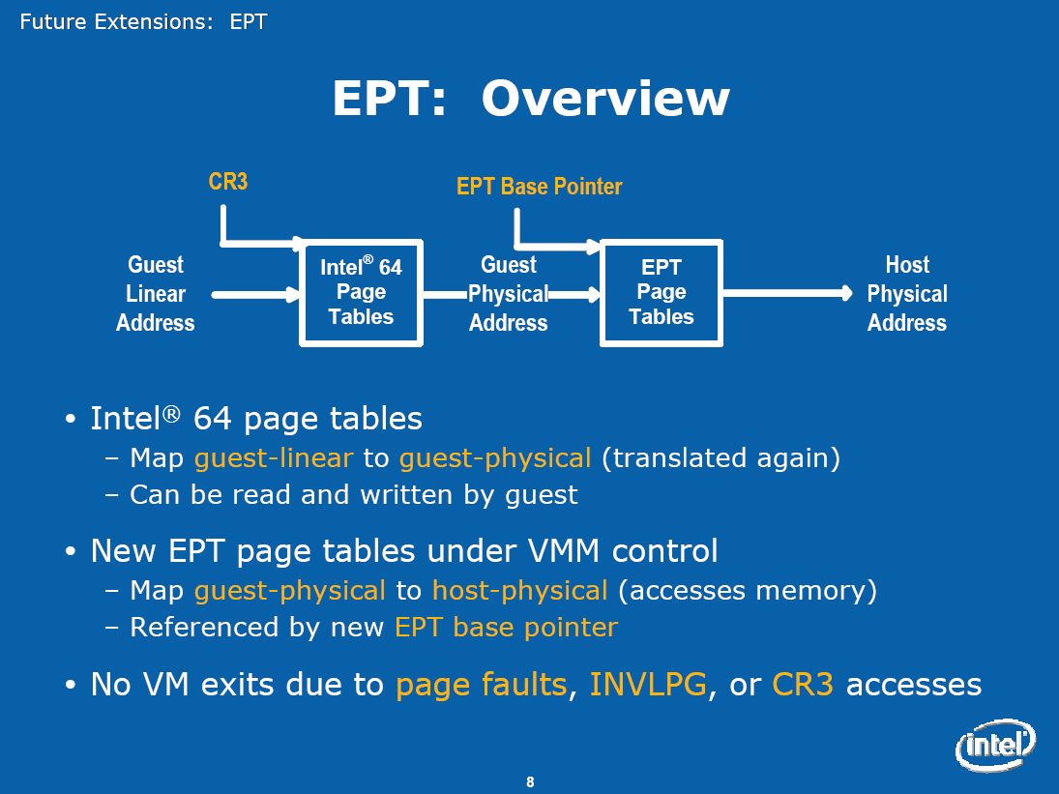
Second generation: Intel EPT & AMD NPT
Eliminating the need to shadow page table

Slide 16
Third generation: Intel VT-d & AMD IOMMU
I/O device assignment
VM owns real device
DMA remapping
Support address translation for DMA
Interrupt remapping
Routing device interrupt

Slide 17
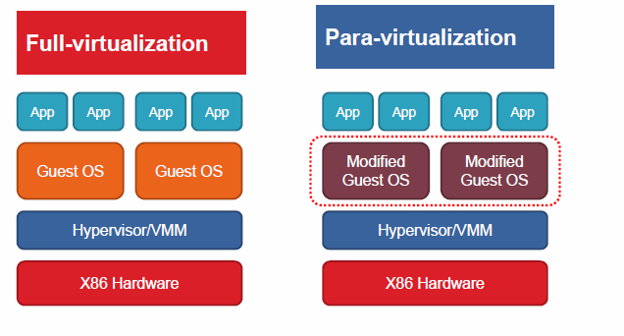
Para-virtualization
Full vs. para virtualization

Slide 18
Xen and the art of virtualization
SOSP’03
Very high impact (data collected in 2013)

Slide 19
Overview of the Xen approach
Support for unmodified application binaries (but not OS)
Keep Application Binary Interface (ABI)
Modify guest OS to be aware of virtualization
Get around issues of x86 architecture
Better performance
Keep hypervisor as small as possible
Device driver is in Dom0

Slide 20
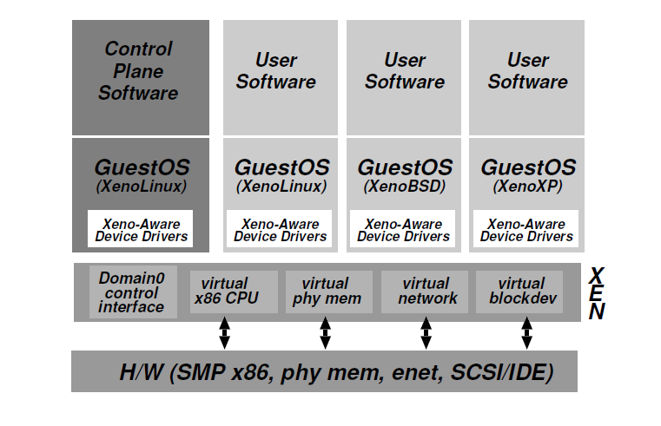
Xen architecture

Slide 21
Virtualization on x86 architecture
Challenges
Correctness: not all privileged instructions produce traps!
Example: popf
Performance:
System calls: traps in both enter and exit (10X)
I/O performance: high CPU overhead
Virtual memory: no software-controlled TLB

Slide 22
CPU virtualization
Protection
Xen in ring0, guest kernel in ring1
Privileged instructions are replaced with hypercalls
Exception and system calls
Guest OS registers handles validated by Xen
Allowing direct system call from app into guest OS
Page fault: redirected by Xen

Slide 23
CPU virtualization (cont.)
Interrupts:
Lighweight event system
Time:
Interfaces for both real and virtual time

Slide 24
Memory virtualization
Xen exists in a 64MB section at the top of every address space
Guest sees real physical address
Guest kernels are responsible for allocating and managing the hardware page tables.
After registering the page table to Xen, all subsequent updates must be validated.

Slide 25
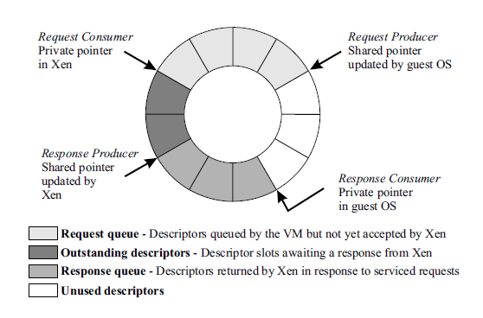
I/O virtualization
Shared-memory, asynchronous buffer descriptor rings

Slide 26
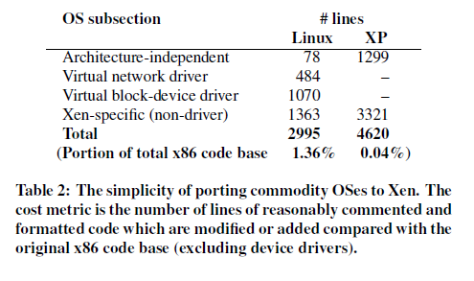
Porting effort

Slide 27
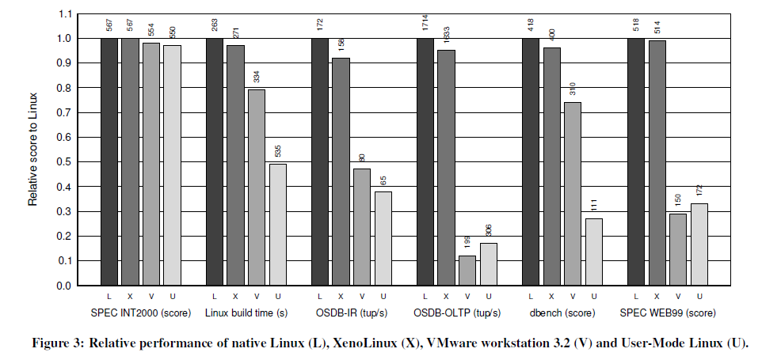
Evaluation

Slide 28
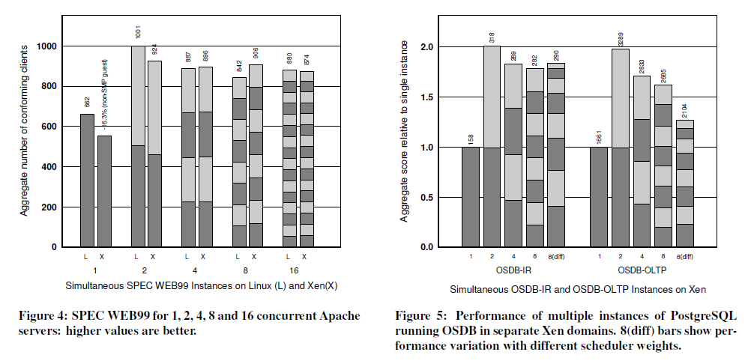
Evaluation

Slide 29
Conclusion
x86 architecture makes virtualization challenging
Full virtualization
unmodified guest OS; good isolation
Performance issue (especially I/O)
Para virtualization:
Better performance (potentially)
Need to update guest kernel
Full and para virtualization will keep evolving together

Slide 30
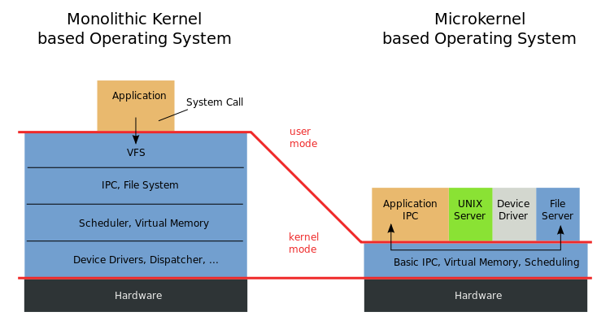
Microkernel vs. VMM(Xen)
Virtual Machine Monitor (VMM): “… software which transforms the single machine interface into the illusion of many. Each of these interfaces (virtual machines) is an efficient replica of the original computer system, complete with all of the processor instructions …“
-- Robert P. Goldberg. Survey of virtual machine research. 1974
Microkernel: "... to minimize the kernel and to implement whatever possible outside of the kernel…“
-- Jochen Liedtke. Towards real microkernels. 1996

Slide 31
Are Virtual Machine Monitors Microkernels Done Right?
Steven Hand, Andrew Wareld, Keir Fraser
HotOS’05
VMMs (especially Xen) are microkernels done right
Avoid liability inversion:
Microkernels depend on some user level components
Make IPC performance irrelevant:
IPC performance is the key in microkernels
Treat the OS as a component
Hard for microkernels to support legacy applications

Slide 32
Are Virtual Machine Monitors Microkernels Done Right?
Gernot Heiser, Volkmar Uhlig, Joshua LeVasseur
ACM SIGOPS’06
VMMs (especially Xen) are microkernels done right.
Avoid liability inversion:
Microkernels depend on some user level components
Make IPC performance irrelevant:
IPC performance is the key in microkernels
Treat the OS as a component
Hard for microkernels to support legacy applications
Really??
Xen also relies on Dom0!
Xen performs the same number of IPC!
Look at L4Linux!

Slide 33
Discussion
What is the difference between VMMs and microkernels?
Why do VMMs seem to be more successful than microkernels?

Slide 34
Conclusion (again)
Virtualization: creating a illusion of something
Virtualization is a principle approach in system design
OS is virtualizing CPU, memory, I/O …
VMM is virtualizing the whole architecture
What else? What next?

